Slide 1
Intro to [Computer] Animation LCC 2730 Prof. Schrank

Slide 2
Lecture Overview
What is Animation?
Four Step Animation Workflow
Squash and Stretch
Use all your Degrees of Freedom!
FEEL the forces at work

Slide 3
Lecture Overview
What is Animation?
Four Step Animation Workflow
Squash and Stretch
Use all your Degrees of Freedom!
FEEL the forces at work

Slide 4
What is Animation?
condition of being alive
state of being full of vigor and vivacity
giving life or spirit
…

Slide 5
What is Animation?

Slide 6
What is Animation?
condition of being alive
state of being full of vigor and vivacity
giving life or spirit
…
rapid display of a sequence of images to create an illusion of movement

Slide 7
Lecture Overview
What is Animation?
Four Step Animation Workflow
Squash and Stretch
Use all your Degrees of Freedom!
FEEL the forces at work

Slide 8
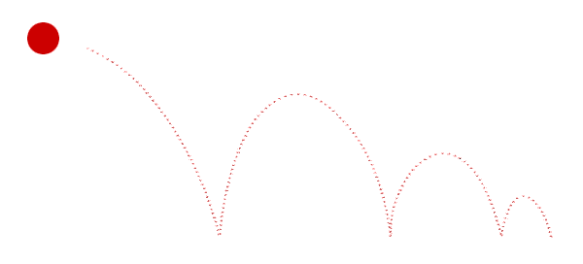
Bouncing a Ball

Slide 9
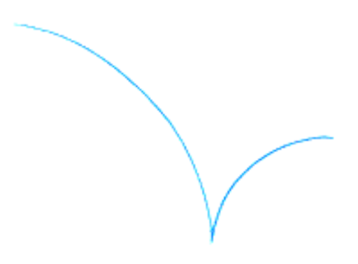
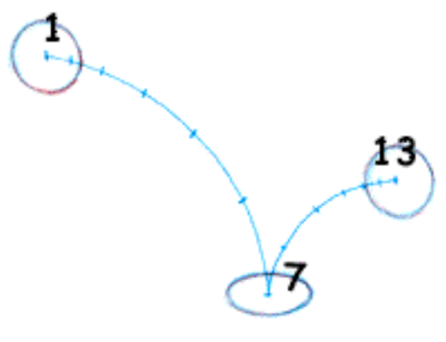
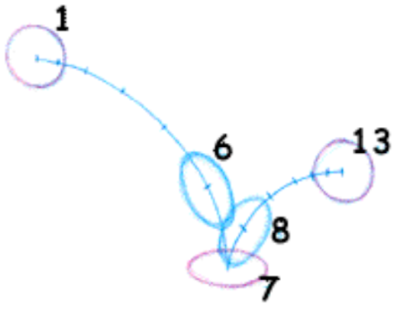
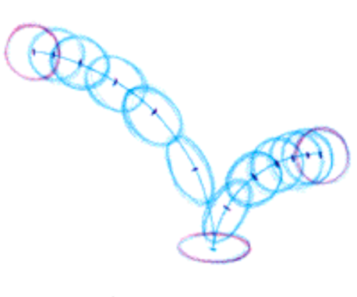
Four Step Animation Workflow:
1. Path of Action
2. Keyframes
3. Breakdown
Frames
4. Interpolated
Frames

Slide 10
1. Path of Action: Arcs

Slide 11
1. Path of Action: Frames

Slide 12
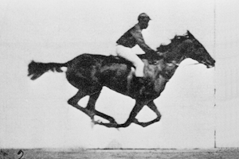
1. Path of Action: Frames

Slide 13
Never evenly space frames

Slide 14
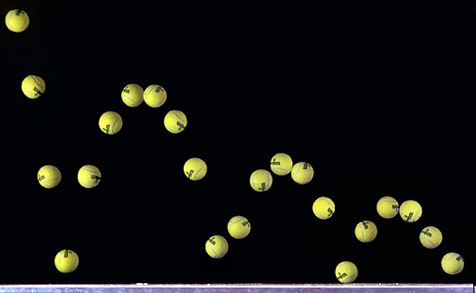
Spacing is always uneven:

Slide 15
2. Keyframes

Slide 16
3. Breakdown Frames

Slide 17
4. Interpolated Frames

Slide 18
Interpolated Frames
Keyframe 1
Keyframe 2

Slide 19
Easing In and Out of Keyframes

Slide 20
Easing In and Out of Keyframes

Slide 21
Interpolated Frames (computer)
In-between Frames (drawn)

Slide 22
Lecture Overview
What is Animation?
Four Step Animation Workflow
Squash and Stretch
Use all your Degrees of Freedom!
FEEL the forces at work

Slide 23
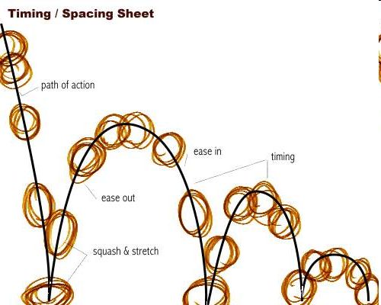
Squash & Stretch

Slide 24
Squash & Stretch

Slide 25
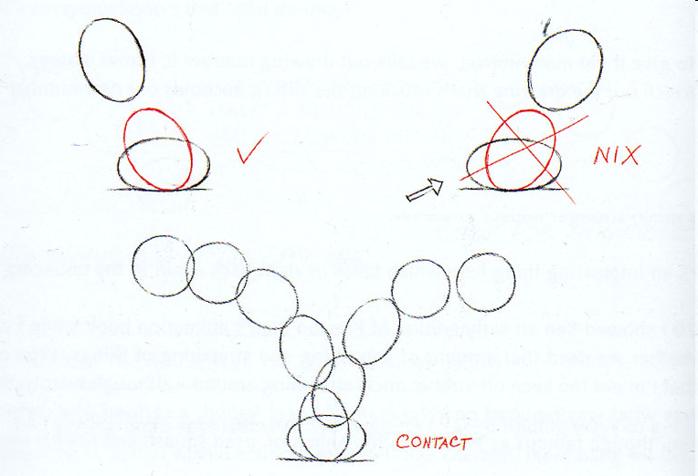
Contact BEFORE not AFTER if you want it to POP…

Slide 26
Contact BEFORE not AFTER if you want it to POP…

Slide 27
Contact BEFORE not AFTER if you want it to POP…

Slide 28
Similar principle behind cartoon impacts:

Slide 29
Similar principle behind cartoon impacts:

Slide 30
Similar principle behind cartoon impacts:

Slide 31
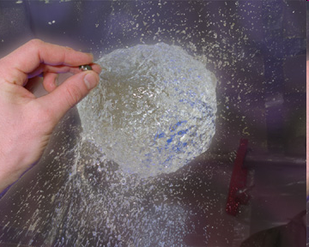
Preserve Volume
When squashing and stretching.

Slide 32
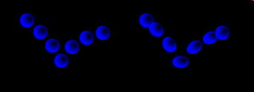
Return to normal before apex:

Slide 33
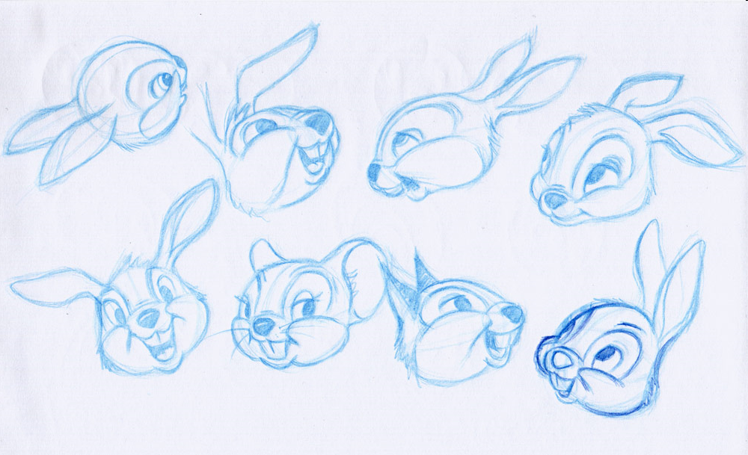
SEE and FEEL the core volume:

Slide 34
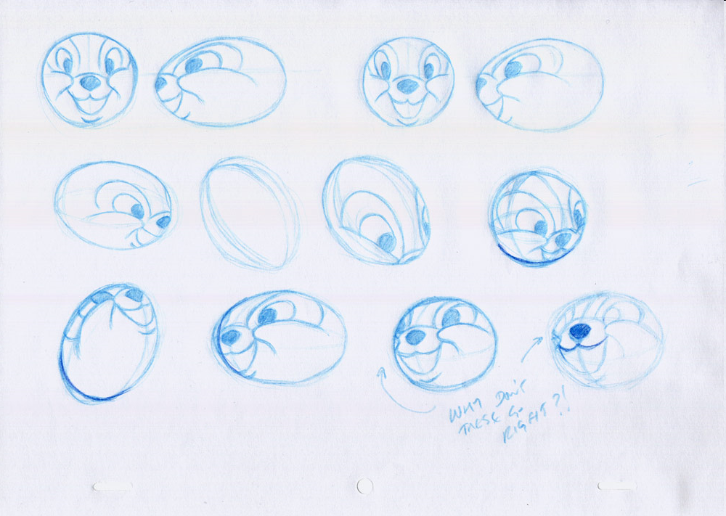
SEE and FEEL the core volume:

Slide 35
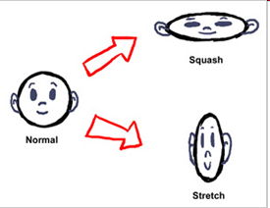
Retain Volume
Volume is redistributed (LOOKS GOOD):

Slide 36
Retain Volume
Volume is lost (LOOKS BAD):

Slide 37
Retain Volume
Mass is gained (LOOKS BAD):

Slide 38
Retain Volume
Volume is redistributed (LOOKS GOOD):

Slide 39
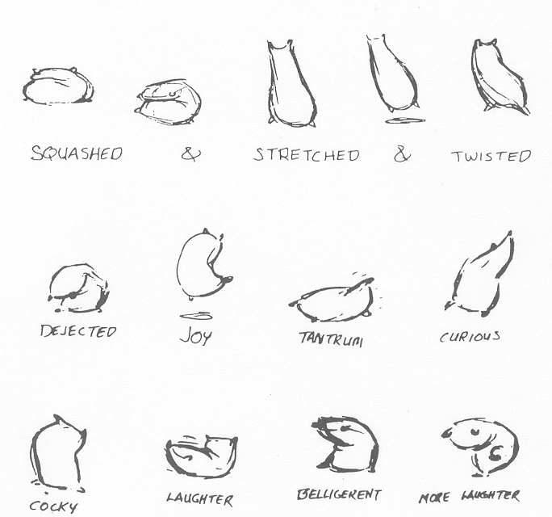
Retain Volume

Slide 40
Lecture Overview
What is Animation?
Four Step Animation Workflow
Squash and Stretch
Use all your Degrees of Freedom!
FEEL the forces at work

Slide 41
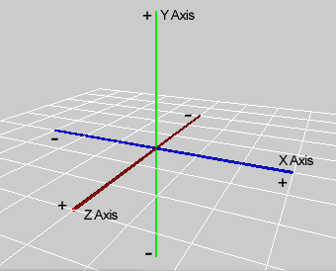
Computational Degrees of Freedom

Slide 42
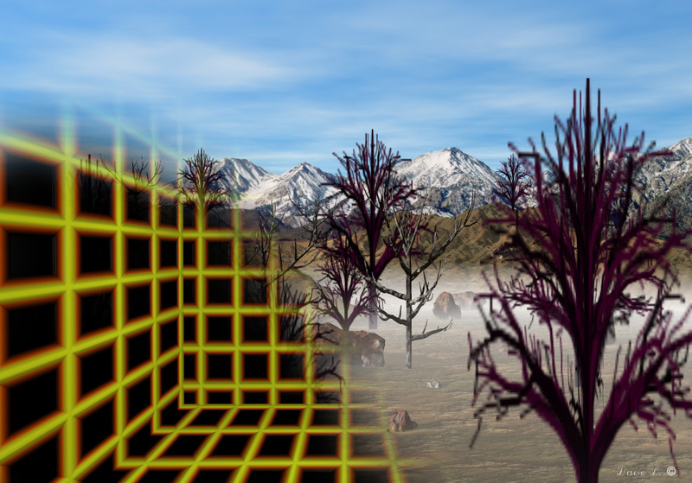
Computational Degrees of Freedom

Slide 43
Use Every Degree of Freedom
All digital animation comes from 9 transforms:
Translate X,Y,Z
Rotate X,Y,Z
Scale X,Y,Z

Slide 44
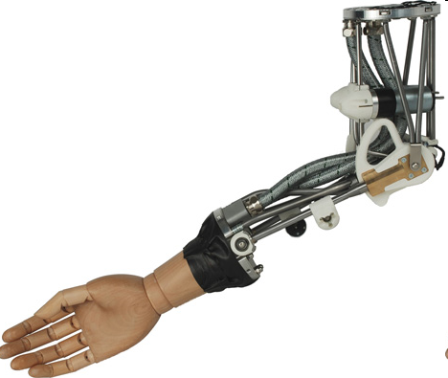
Use Every Degree of Freedom
Translate X,Y,Z
Rotate X,Y,Z
Scale X,Y,Z

Slide 45
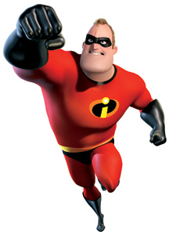
Use Every Degree of Freedom
Translate X,Y,Z
Rotate X,Y,Z
Scale X,Y,Z

Slide 46
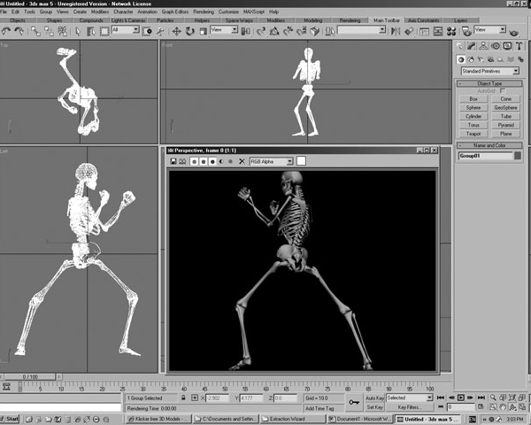
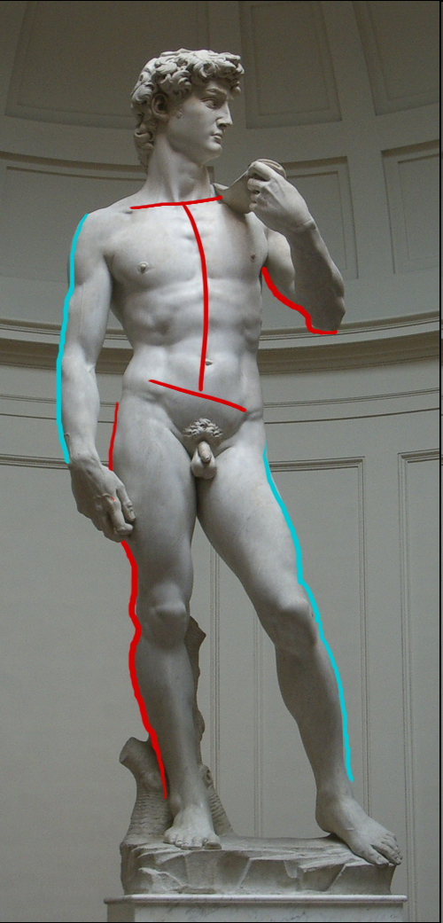
The most common mistake new animators make neglecting to use all the object’s………. ……………………….Degrees of Freedom.

Slide 47
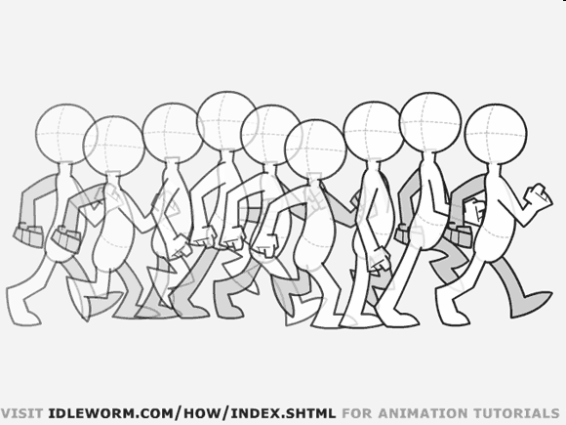
The most common mistake new animators make neglecting to use all the object’s………. ……………………….Degrees of Freedom.

Slide 48
Lecture Overview
What is Animation?
Four Step Animation Workflow
Squash and Stretch
Use all your Degrees of Freedom!
FEEL the forces at work

Slide 49
Try to FEEL the forces at work in your moving imagery.

Slide 50
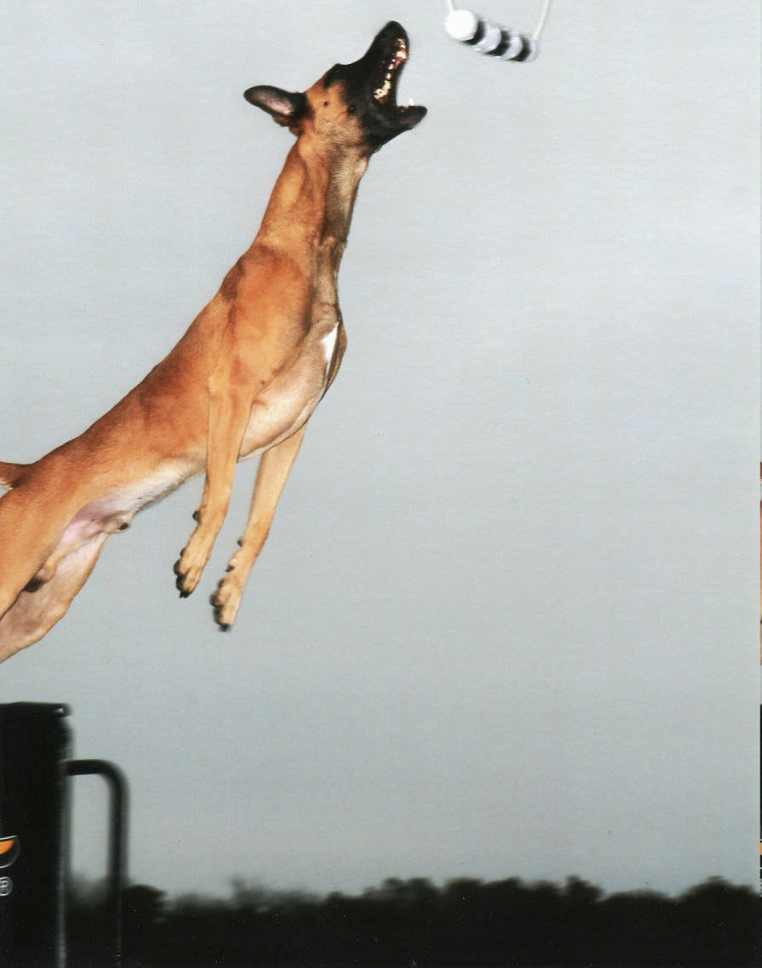
How does the dog’s body FEEL in this moment?

Slide 51
How are the forces FIGHTING over control of its body?
Is the dominant force becoming external?

Slide 52
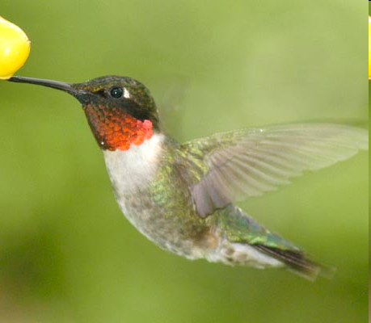
How does a loose equilibrium of forces FEEL in this bird’s body?

Slide 53
How does a loose equilibrium of forces FEEL in this bird’s body?

