Slide 1
Projects Anticipation Staging Action LCC 2730 Prof. Schrank

Slide 2
Lecture Overview
Project Advice
Anticipation
each action is a micronarrative
Staging
of Character (Silhouette)
of Camera (Composition)

Slide 3
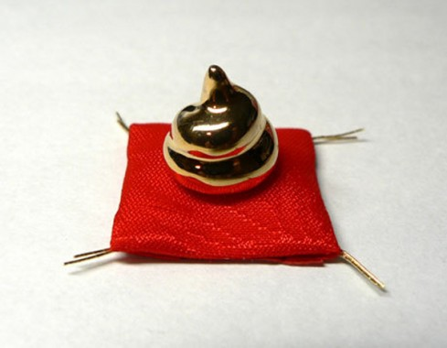

Slide 5
These wont cover up bad work, they’ll only make it worse:
Textures
Lighting
Cinematography
Long animations

Slide 6
These will not cover up crap. They will only make it worse.
Nail the Basic Principles First
Textures
Lighting
Cinematography
Length of animation
Nail the Basic Principles First
Nail the Basic Principles First

Slide 7
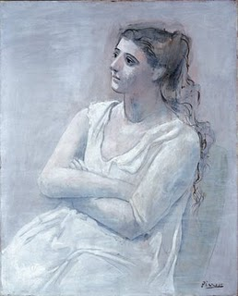
Build a Strong Foundation First:

Slide 8
Then elaborate and innovate:

Slide 9
Nail the Basics in your Projects:
Squash and Stretch
Use it!

Slide 10
Nail the Basics in your Projects:
Squash and Stretch
Use it!
Arcs
Triple check your spacing, then check it again

Slide 11
Nail the Basics in your Projects:
Squash and Stretch
Use it!
Arcs
Triple check your spacing, then check it again
Flow
Believable pace of movement
Ease in and out of apex

Slide 12
Nail the Basics in your Projects:
Squash and Stretch
Use it!
Arcs
Triple check your spacing, then check it again
Flow
Believable pace of movement
Ease in and out of apex
Cohesion
“Tell the story” every way possible

Slide 13
Lecture Overview
Project Advice
Anticipation
each action is a micronarrative
Staging
of Character (Silhouette)
of Camera (Composition)

Slide 14
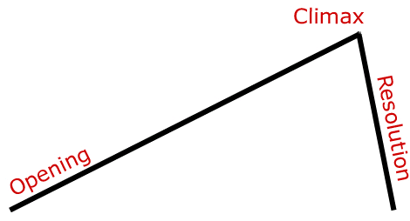
narrative
structure
(plot)

Slide 15
narrative
structure
(plot)
micronarrative
structure
(mini-plot)

Slide 16
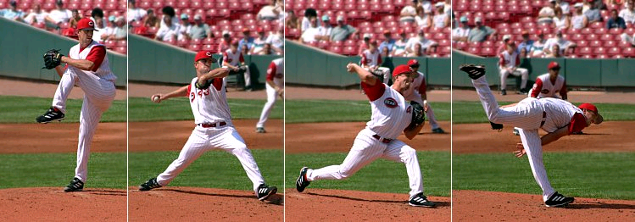
An action is a micronarrative:

Slide 17
An action is a micronarrative:
Anticipate the Action
Do the Action
Show we’ve done it
(let it hang a second)

Slide 18
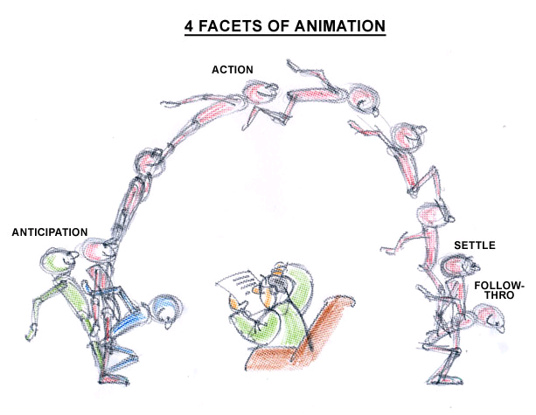
Each action is a micronarrative:

Slide 19
Anticipation:
Prepares viewer for what’s about to happen
Stages the following action
Strengthens that action through contrast
Adds physical believability
proprioception / visual impact

Slide 20
Degrees of Anticipation

Slide 21
How would you… add a little anticipation here?

Slide 22
How would you… add a little anticipation here?

Slide 23
Anticipation Brainstorm…
Water balloon
Squash before jumping off
Stretch (in fear) before other ball lands on it
Roll back before shoving other ball
Bowling ball
Roll back before falling off
Roll back before shoving other ball

Slide 24
Anticipation Brainstorm…
Water balloon
Squash before jumping off
Stretch (in fear) before other ball lands on it
Roll back before shoving other ball
Bowling ball
Roll back before falling off
Roll back before shoving other ball
Spin in place before jumping (squealing tires)

Slide 25
Lecture Overview
Project Advice
Anticipation
each action is a micronarrative
Staging
of Character (Silhouette)
of Camera (Composition)

Slide 26
Clear Silhouettes

Slide 27
Clear Silhouettes

Slide 28
Clear Silhouettes

Slide 29
Clear Silhouettes

Slide 30
Strong Silhouettes

Slide 31
Strong Silhouettes

Slide 32
Strong Silhouettes

Slide 33
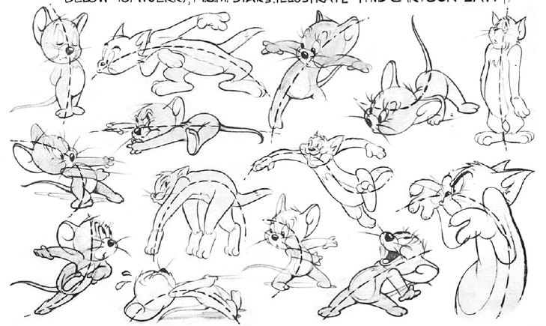
Clear Pose Lines

Slide 34
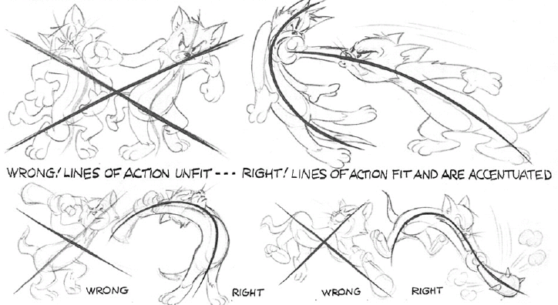
Clear Lines of Action

Slide 35
Clear Lines of Action
Side view is clear
Top view is unclear

Slide 36
Lecture Overview
Project Advice
Anticipation
each action is a micronarrative
Staging
of Character (Silhouette)
of Camera (Composition)

Slide 37
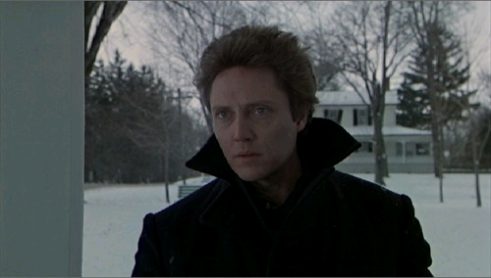
When it comes to Composition:
Strive for Clarity, Clarity, Clarity

Slide 38
When it comes to Composition:
Strive for Clarity, Clarity, Clarity
If the audience can’t clearly see the action,
the shot wont have much meaning anyway.

Slide 39
Imagine your audience is
1/3 as interested
as you are.

Slide 40
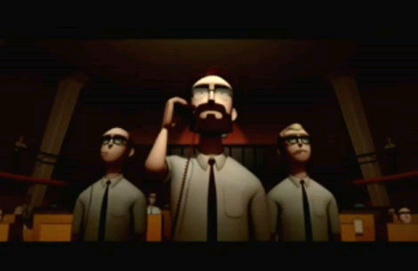
Camera Angle First!
Set up camera BEFORE you begin animating
Concentrate on what the camera sees and animate around that.

Slide 41
Camera Angle First!
Set up camera BEFORE you begin animating
Concentrate on what the camera sees and animate around that.

Slide 42
Finding the Right Distance
Long
Shot is about “where and when”
Good for establishing shots
Broad and clear description of space
Characters look small in the world
Medium
Shot is about “who and what”
Character actions in world
Close Up
Shot is about “who and how do they feel”
Characters in emotional relationship to each other

Slide 43
Finding the Right Angle
High—looking down at character
Characters look weak and small
Audience is powerful / adult
Eye-line—looking horizontally straight at character
“Transparent” view, feels “unmediated”
Characters appear normal
Low—looking up at character
Character appear powerful and large
Audience is weak / childlike

Slide 44
Negative Space has Meaning
Can signify lack, that’s something missing

Slide 45
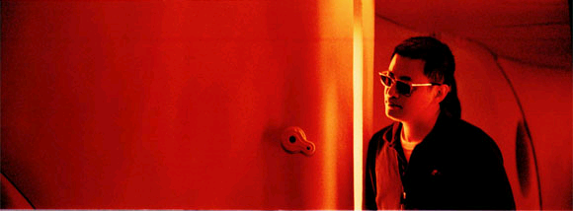
Negative Space has Meaning
Opens the space where character is going. Lies dormant, then is activated.

Slide 46
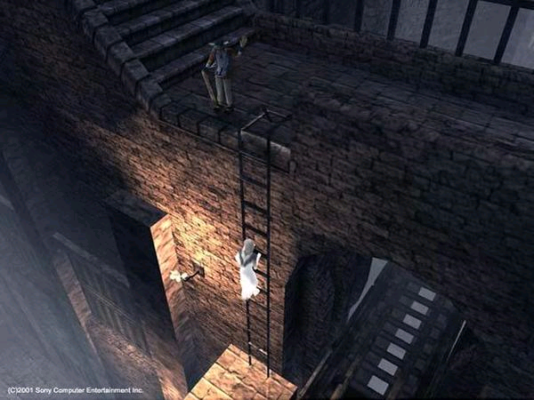
Negative Space has Meaning
Signifies potential, the future…

Slide 47
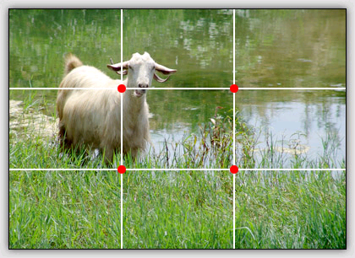
Rule of Thirds

Slide 48
Which is more interesting?

Slide 49
