Slide 1
Propaganda
Principles of Visual Design LCC 2720 Instructor: Brian Schrank

Slide 3
Lecture Overview
Introduction
Two Levels of Propaganda
Systemic (pervasive, status quo)
Acute (protest, challenge status quo)
Three Types of Propaganda
Political
Ideological
Commercial
International Propaganda

Slide 4
Arose in WWI – WWII

Slide 5
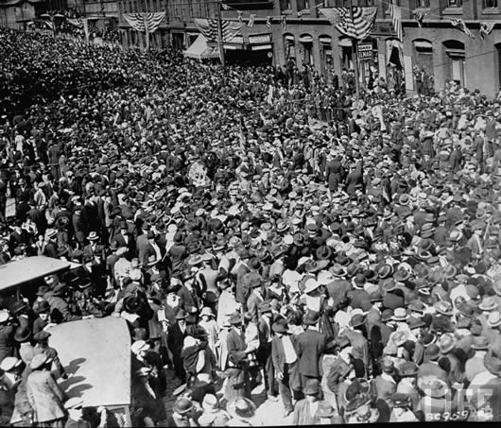
Propaganda began as a governmental tool to influence the new urban masses.

Slide 6
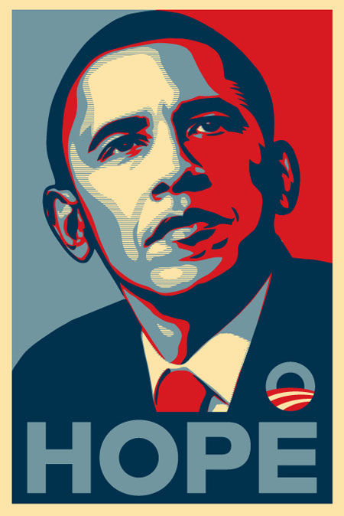
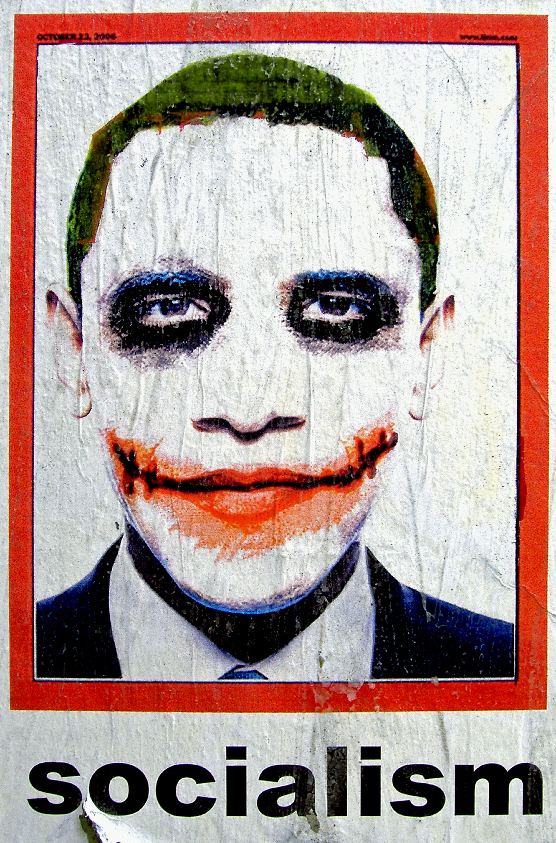
Propaganda is Common Today
…and it is not only used by governments.

Slide 7
What is Propaganda?
Propaganda is media that deliberately shapes perceptions, manipulates thought, and directs viewer behavior toward an agenda.

Slide 8
Propaganda Manipulates through Emotions
Propaganda selectively uses strong images and loaded messages to produce an emotional and irrational, rather than rational response, to the information presented.

Slide 9
Who Uses Propaganda?
Governments
Political Parties
Corporations
Special Interest Groups
Liberal example: Code Pink
Conservative example: National Right to Life
Anarchist example: Anonymous

Slide 10
Two Levels of Propaganda
Systemic Propaganda
Pervasive
Repeated often
Top-down
Creates “common sense”
Acute Propaganda
Not pervasive
Unusual to see
Bottom-up
Challenges “common sense”

Slide 11
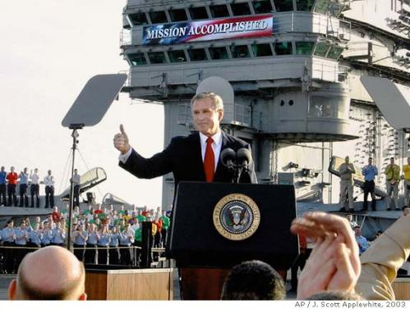
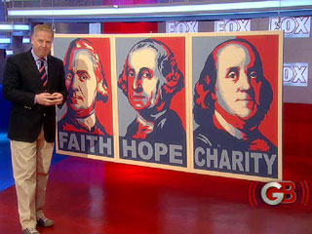
Systemic Propaganda
Determines “common sense”
Liberals see it in:
the popular belief of American Exceptionalism

Slide 12
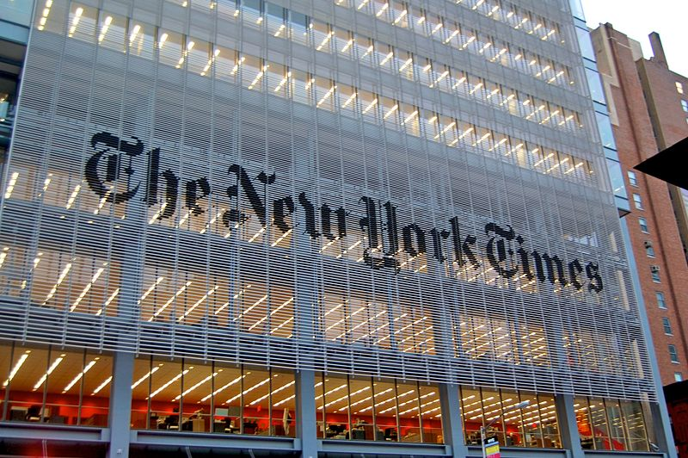
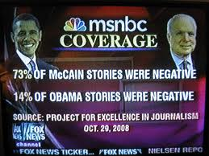
Systemic Propaganda
Determines “common sense”
Conservatives see it in:
the liberal bias of mainstream media

Slide 13
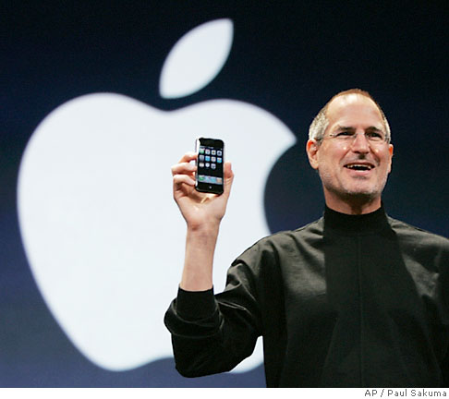
Systemic Propaganda
Determines “common sense”
Anarchists see it in:
the popular desire to consume and acquire products

Slide 14
Systemic Propaganda
Determines “common sense”
Feminists see it in:
the popular objectification of women in media

Slide 15
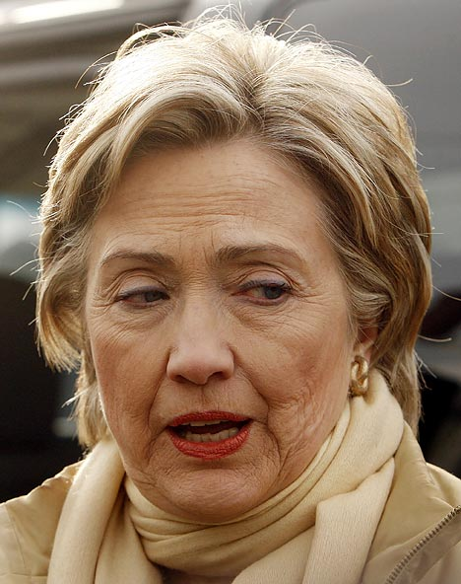
Systemic Propaganda
Determines “common sense”
Feminists see it in:
the sexism toward women in politics

Slide 16
Two Levels of Propaganda
Systemic Propaganda
Pervasive
Repeated often
Top-down
Creates “common sense”
Acute Propaganda
Not pervasive
Unusual to see
Bottom-up
Challenges “common sense”

Slide 17
Acute Propaganda
Advance American Exceptionalism
Challenge American Exceptionalism

Slide 18
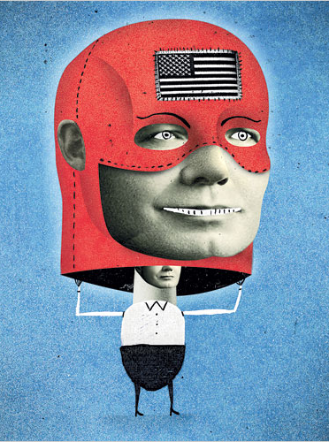
Acute Propaganda

Slide 19
Acute Propaganda
Liberal Bias in Mass Media
Tea Party
Take America Back Convention
Glenn Beck

Slide 20
Acute Propaganda

Slide 21
Acute Propaganda
Consumerism
Anti-consumerism

Slide 22
Acute Propaganda

Slide 23
Acute Propaganda
Sexism in Mass Media
Objectification of Women
Feminist Protest
Challenge Objectification

Slide 24
Acute Propaganda

Slide 25
Acute Propaganda
Presents what is NOT present in mass media
Exposes mainstream bias
Challenges social conventions
Redefines “common sense”

Slide 26
Three Types of Propaganda
Political
Governments, Political Parties
Ideological
Special Interest Groups
Anti-Government
Anti-Corporate
Commercial
Corporations

Slide 27
Three Types of Propaganda
Political
Governments, Political Parties

Slide 28
Historical Political Propaganda
Purposes of Political Propaganda:
Ensure the masses perform civil duties
Nationalism, national solidarity, patriotism
World War II war effort

Slide 29
How to Design (Historical) Propaganda
Be Bold
Simple Shapes
Simple Color Palettes (at least one primary color)
High Contrast
Be Dynamic
Energetic
Diagonal Compositions
Fuse Ideas
Merge Fear into the Message
Merge Desire into the Message

Slide 30
Historical Political Propaganda
Civil Duties: Production (connecting work, war)

Slide 31
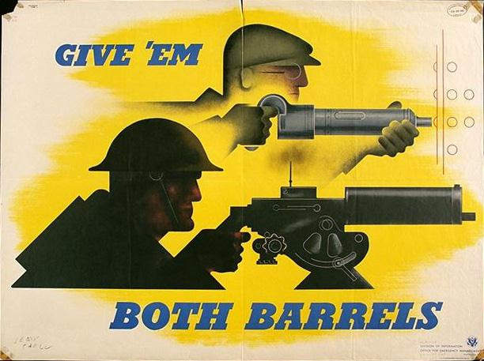
Historical Political Propaganda
Civil Duties: Production (worker = warrior)

Slide 32
Historical Political Propaganda
Civil Duties: Production (women taking over men’s duties)

Slide 33
Historical Political Propaganda
Civil Duties: Health (good health is your duty)

Slide 34
Historical Political Propaganda
Civil Duties: Health (fear tactics)

Slide 35
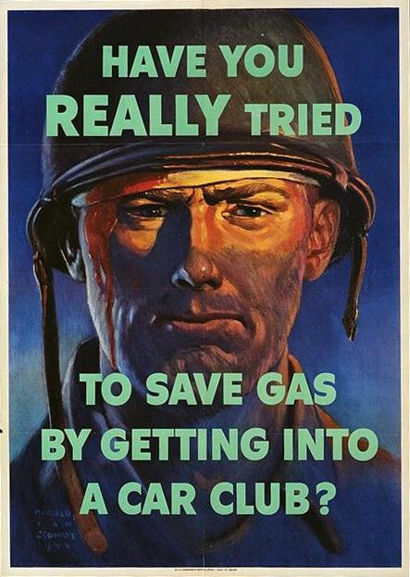
Historical Political Propaganda
Civil Duties: Rationing (fear tactics)

Slide 36
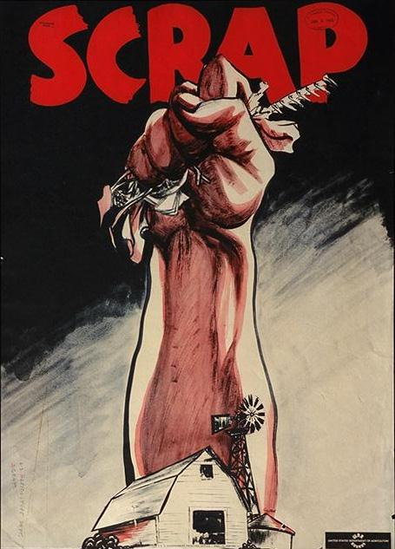
Historical Political Propaganda
Civil Duties: Rationing (connections to strength)

Slide 37
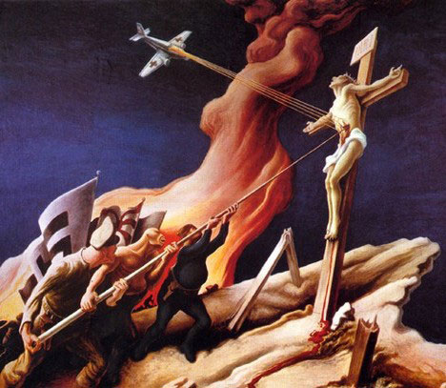
Historical Political Propaganda
Civil Duties: Support the Religious War

Slide 38
Historical Political Propaganda
Civil Duties: Support the Religious War

Slide 39
Historical Political Propaganda
Civil Duties: Soldier Silence through Fear

Slide 40
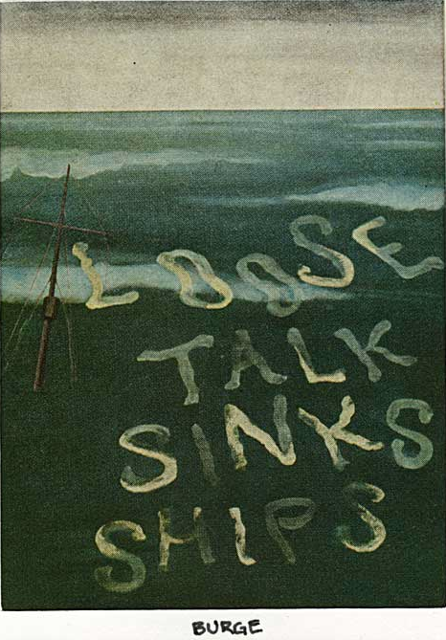
Historical Political Propaganda
Civil Duties: Soldier Silence through Fear

Slide 41
Historical Political Propaganda
Civil Duties: Citizen Silence… more casual

Slide 42
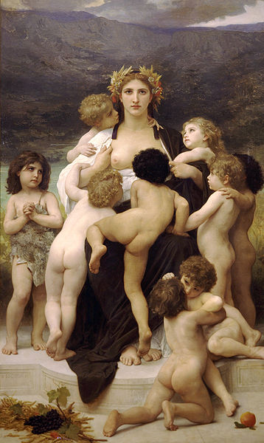
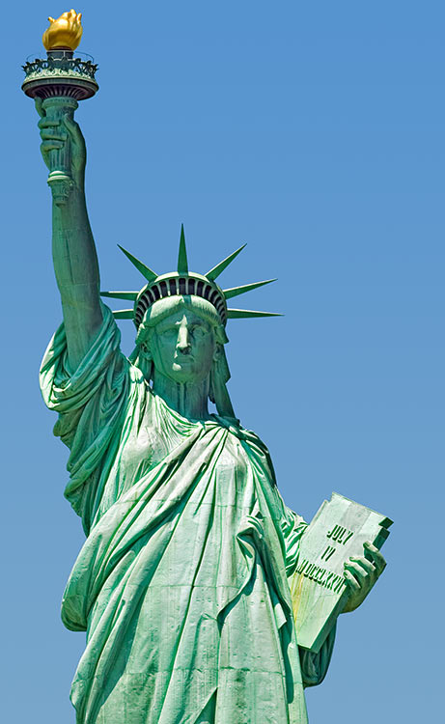
Historical Political Propaganda
Civil Duties: Love of Motherland (majesty, awe)

Slide 43
Historical Political Propaganda
Civil Duties: Paranoia

Slide 44
Historical Political Propaganda
Civil Duties: General Caution

Slide 45
Historical Political Propaganda
Civil Duties: Remain Calm

Slide 46
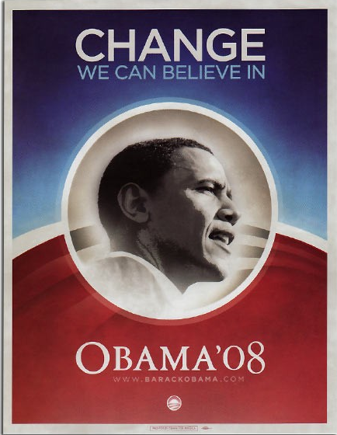
Contemporary Political Propaganda
Support of Political Candidates

Slide 47
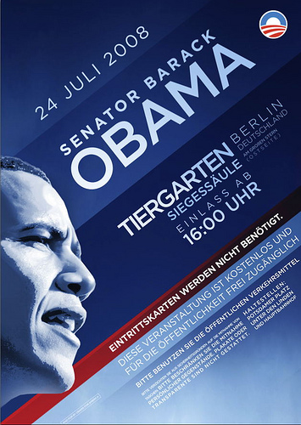
Contemporary Political Propaganda
Support of Political Candidates

Slide 48
Contemporary Political Propaganda
Support of Political Candidates

Slide 49
Contemporary Political Propaganda
Support of Political Candidates

Slide 50
Contemporary Political Propaganda
Civil Duties: Health (through disgust)

Slide 51
Contemporary Political Propaganda
Civil Duties: Anti-drugs (through fear, disgust)

Slide 52
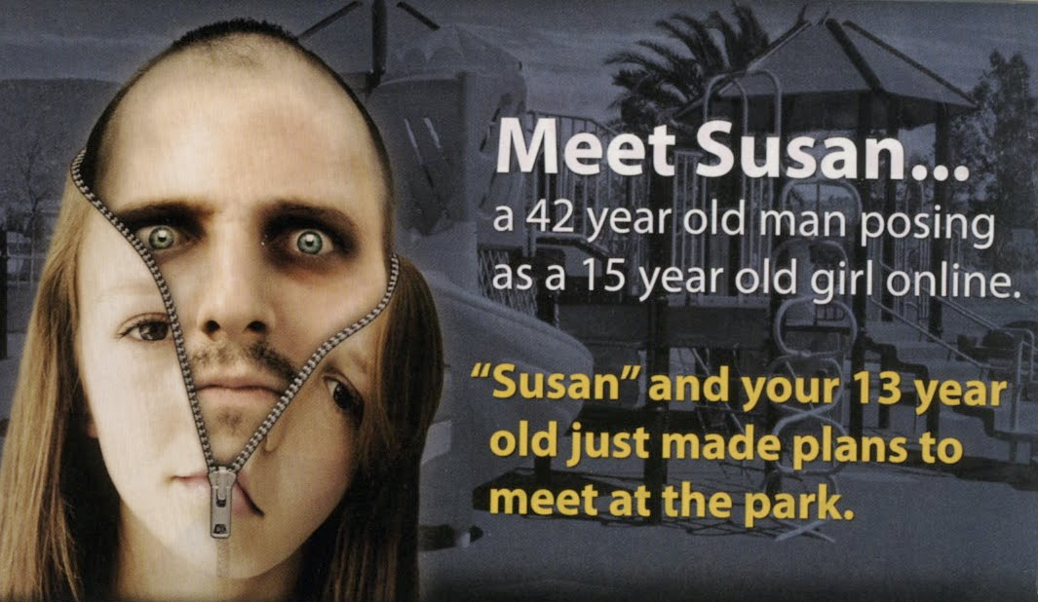
Contemporary Political Propaganda
Civil Duties: Internet Vigilance (through fear)

Slide 53
Contemporary Political Propaganda
Civil Duties: Support of Military, Recruitment

Slide 54
Contemporary Political Propaganda
Civil Duties: Paranoia/Vigilance toward Terrorism

Slide 55
Contemporary Political Propaganda
Civil Duties: Paranoia/Vigilance toward Terrorism

Slide 56
Three Types of Propaganda
Political
Governments, Political Parties
Ideological
Special Interest Groups
Anti-Government
Anti-Corporation
Commercial
Corporations

Slide 57
Ideological Propaganda
Animal Rights: Disgust, Desire, Violence

Slide 58
Ideological Propaganda
Animal Rights: Desire, Celebrity

Slide 59
Ideological Propaganda
Animal Rights: Desire, Patriotism

Slide 60
Ideological Propaganda
Animal Rights: Desire, Tie in Human Violence

Slide 61
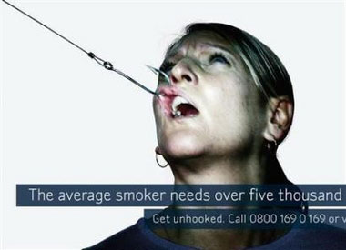
Ideological Propaganda
Anti-Smoking: Tie in Animal Violence

Slide 62
Ideological Propaganda
Pro-Life: Humanize Fetus, Innocence, Love

Slide 63
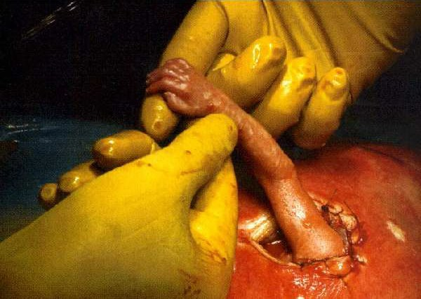
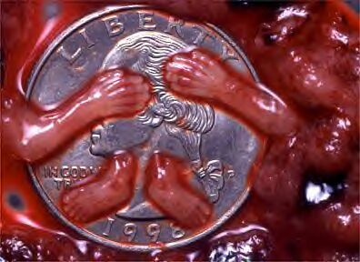
Ideological Propaganda
Pro-Life: Humanize Fetus, Hidden Violence

Slide 64
Ideological Propaganda
Pro-Choice: Tie in War, Freedom, Rape

Slide 65
Ideological Propaganda
Pro-Choice: Politically Backwards, Prison, Violent

Slide 66
Ideological Propaganda
Environmental Issues: Humanize Nature

Slide 67
Ideological Propaganda
Careful Driving: Sleepy Eyes = Crash

Slide 68
Ideological Propaganda
Anarchist: Power as Corrupt, Power as Violent

Slide 69
Ideological Propaganda
Anarchist: Tie in War, Death, and Consumerism

Slide 70
Ideological Propaganda
Democratic: Tie in Death and Torture

Slide 71
Ideological Propaganda
Democratic: Clever, Figurative Mutilation

Slide 72
Three Types of Propaganda
Political
Governments, Political Parties
Ideological
Special Interest Groups
Anti-Government
Anti-Corporation
Commercial
Corporations

Slide 73
Commercial Propaganda
Systemic Propaganda
Pervasive
Repeated often
Top-down
Creates “common sense”
Acute Propaganda
Not pervasive
Unusual to see
Bottom-up
Challenges “common sense”

Slide 74
Commercial Propaganda

Slide 75
Commercial Propaganda

Slide 76
Commercial Propaganda

Slide 77
Commercial Propaganda
?
?
?

Slide 78
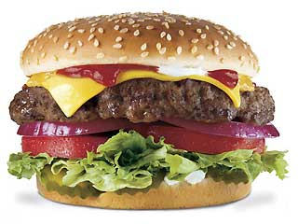
Commercial Propaganda

Slide 79
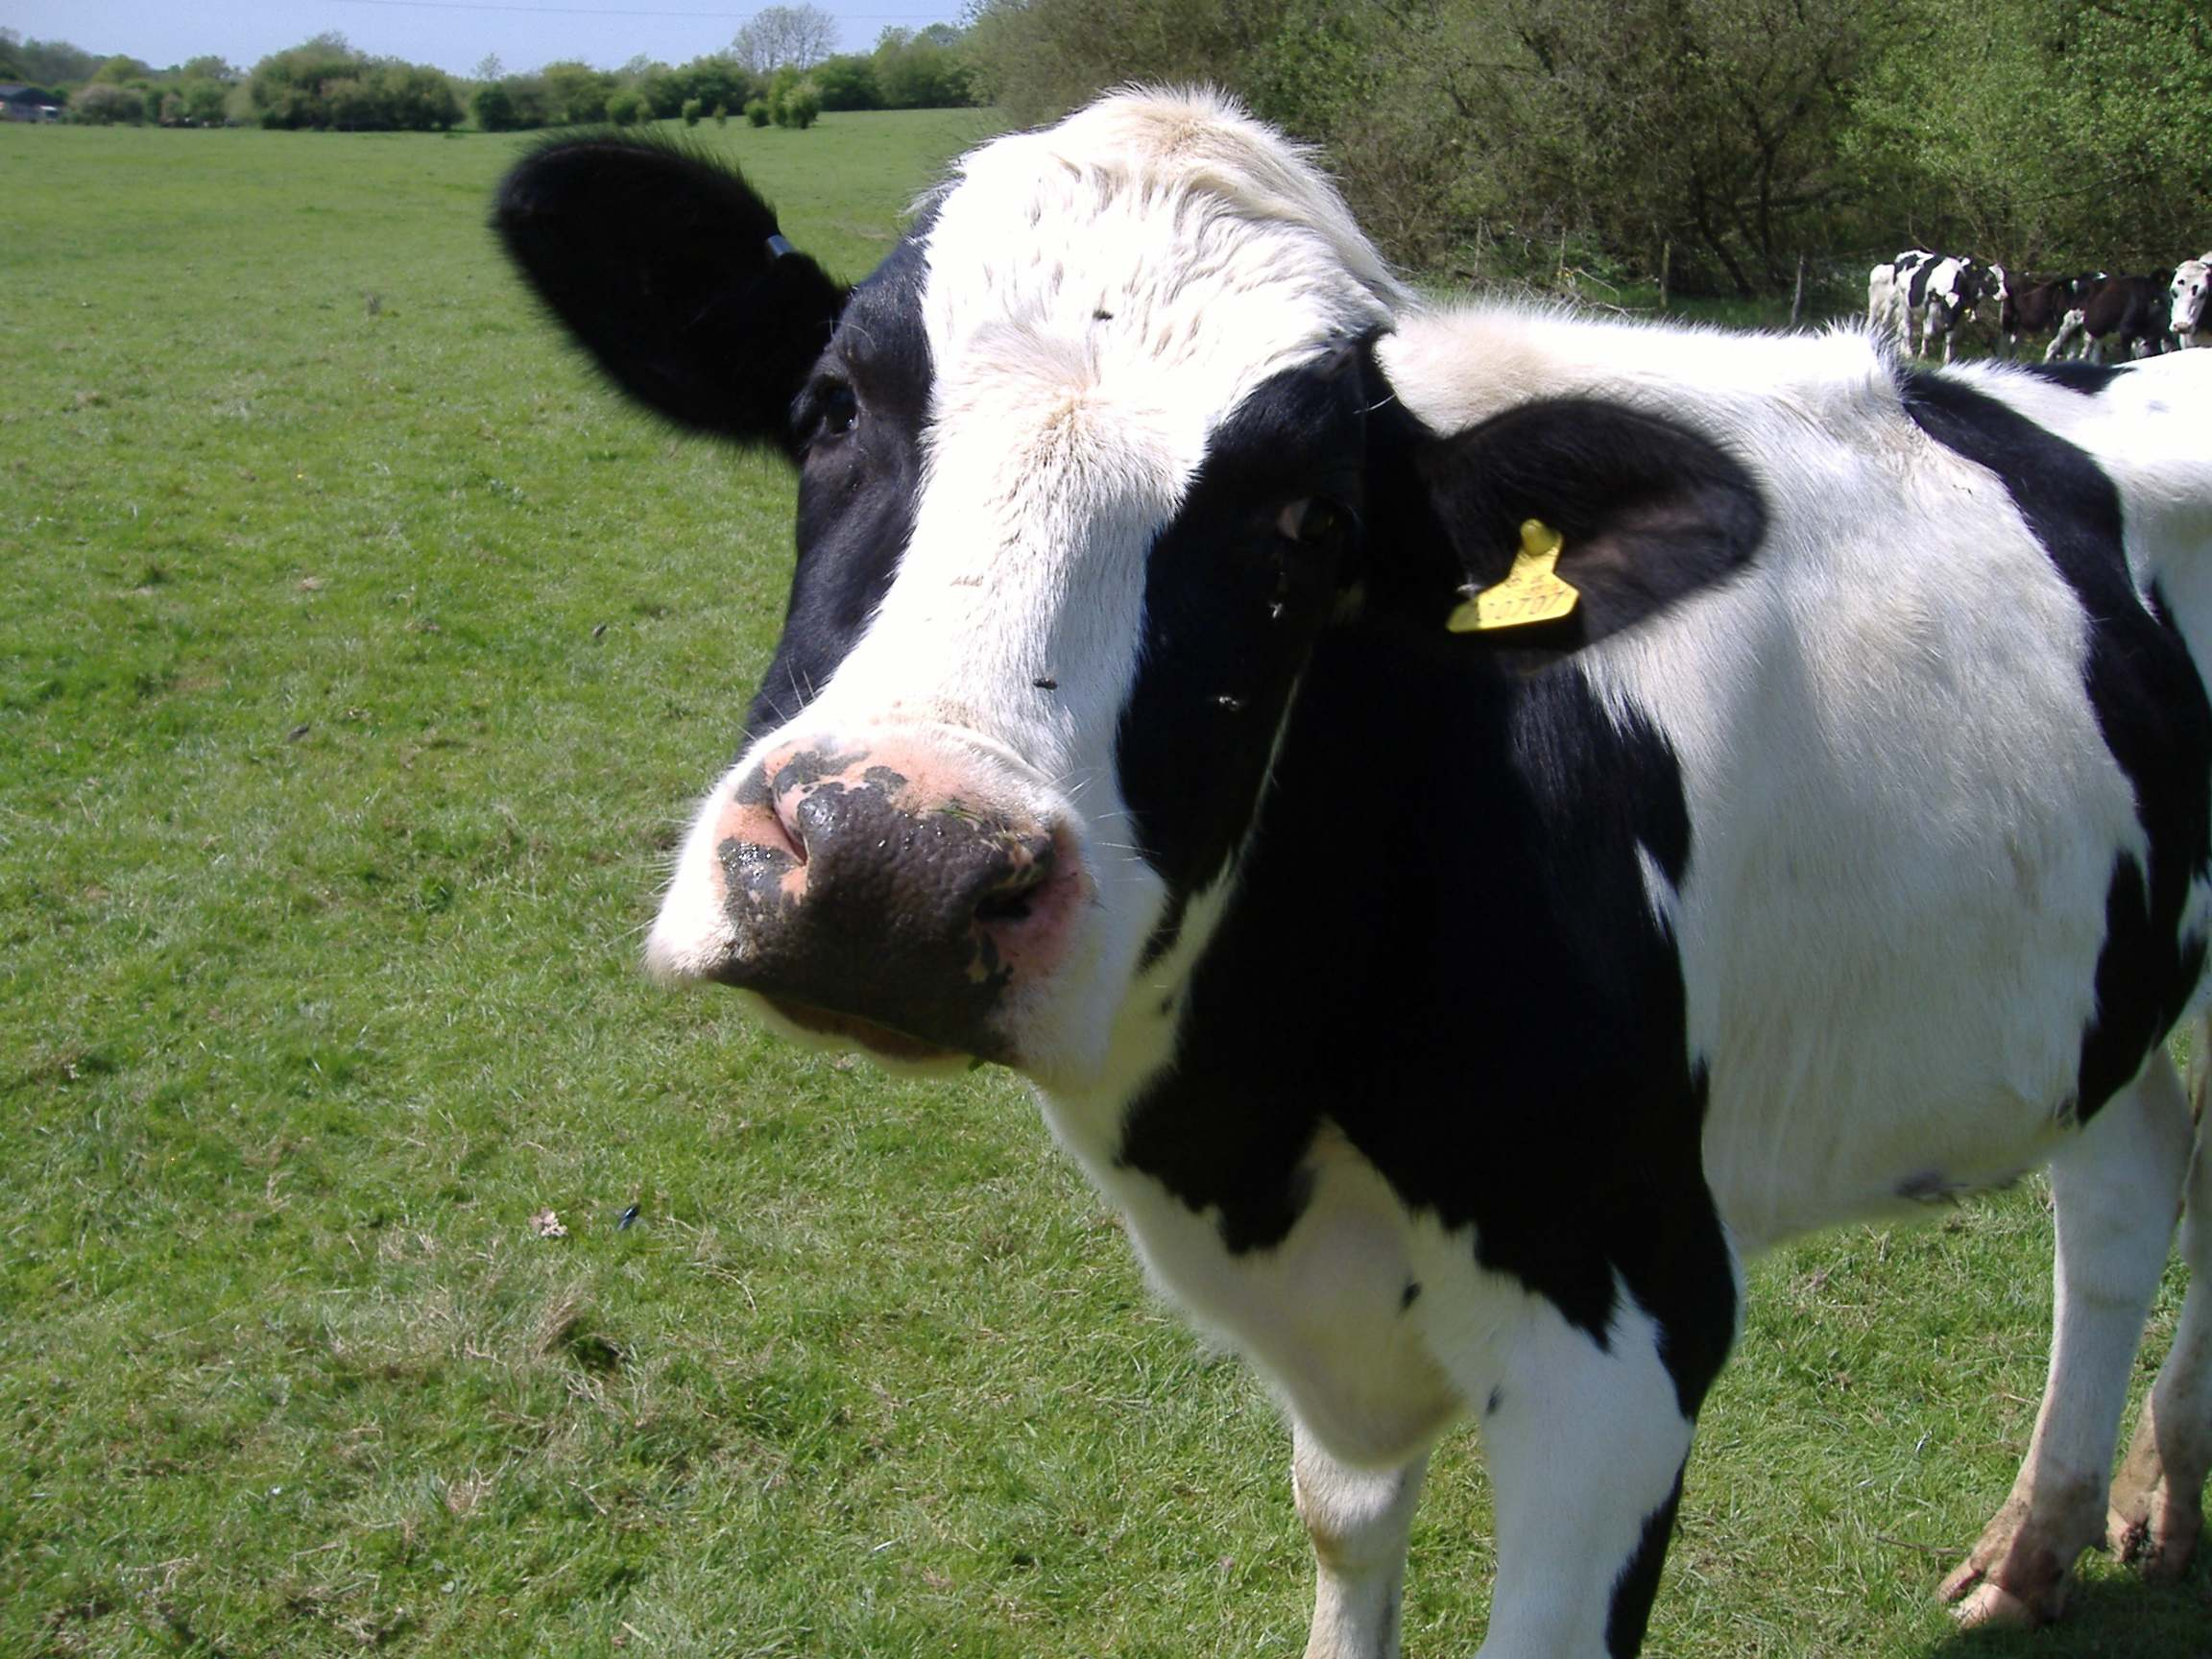
Commercial Propaganda

Slide 80
International Propaganda

Slide 81
How to Design (Historical) Propaganda
Be Bold
Simple Shapes
Simple Color Palettes (at least one primary color)
High Contrast
Be Dynamic
Energetic
Diagonal Compositions
Fuse Ideas
Merge Fear into the Message
Merge Desire into the Message

Slide 82
Spanish Propaganda
s

Slide 83
Spanish Propaganda
s

Slide 84
German Propaganda
s

Slide 85
Israeli Propaganda
s

Slide 86
British Propaganda
s

Slide 87
Russian Propaganda
s

Slide 88
Russian Propaganda

Slide 89
Russian Propaganda
s

Slide 90
North Korean Propaganda
s

Slide 91
North Korean Propaganda
s

Slide 92
North Korean Propaganda
s

Slide 93
Chinese Propaganda
s

Slide 94
Chinese Propaganda
s

Slide 95
Norwegian Propaganda
s

Slide 96
French Propaganda
s

Slide 97
Canadian Propaganda
s

Slide 98
Serbian Propaganda
s

