Slide 1
Professional Website Portfolios
Principles of Visual Design LCC 2720 Brian Schrank

Slide 2
Portfolio Lecture Overview
Remember the basics of design
Simple Portfolio Layouts
Flowcharts and Planning
Target your Portfolio
Galleries and Images
Embedding Videos

Slide 3
What does “CRAP” stand for?
C
R
A
P

Slide 4
What does “CRAP” stand for?
Contrast
Repetition
Alignment
Proximity

Slide 5
Apply the Basics of Design:
Contrast draws and holds the eye to the page.
Choose certain elements to stand out from the rest in terms of color, scale, shape.
Choose ONE element (logo, image) to stand out.

Slide 6
Apply the Basics of Design:
Contrast draws and holds the eye to the page.
Choose certain elements to stand out from the rest in terms of color, scale, shape.
Repetition unifies the site.
Make page layout elements similar in size, color, shape, etc., so the site feels cohesive.
Chose a limited Color Palette and stick to it.
Chose one typeface and stick to it.

Slide 7
Apply the Basics of Design:
Contrast draws and holds the eye to the page.
Choose certain elements to stand out from the rest in terms of color, scale, shape.
Repetition unifies the site.
Make page layout elements similar in size, color, shape, etc., so the site feels cohesive.
Alignment leads the eye.
Flow lines within a page help the eye move over the site, making it visually appealing.
Proximity logically chunks elements together.
Spatially group elements that belong together.

Slide 8
Apply the Basics of Design:
Contrast draws and holds the eye to the page.
Choose certain elements to stand out from the rest in terms of color, scale, shape.
Repetition unifies the site.
Make page layout elements similar in size, color, shape, etc., so the site feels cohesive.
Alignment leads the eye.
Flow lines within a page help the eye move over the site, making it visually appealing.
Proximity logically chunks elements together.
Spatially group elements that belong together.

Slide 9
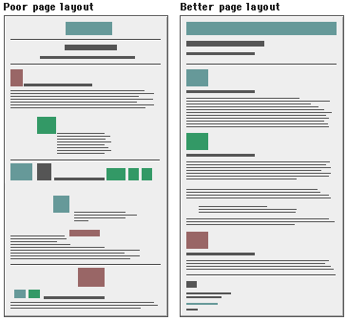
Bad Layout vs. Good Layout
Contrast
Repetition
Alignment
Proximity

Slide 10
Good Portfolios Can Be Simple
http://kylegabler.com/oldsite/

Slide 11
Good Portfolios Can Be Simple
http://kylegabler.com/oldsite/

Slide 12
Good Portfolios Can Be Simple
http://kylegabler.com/oldsite/

Slide 13
Good Portfolios Can Be Simple
http://www.lefttomyowndevices.com/

Slide 14
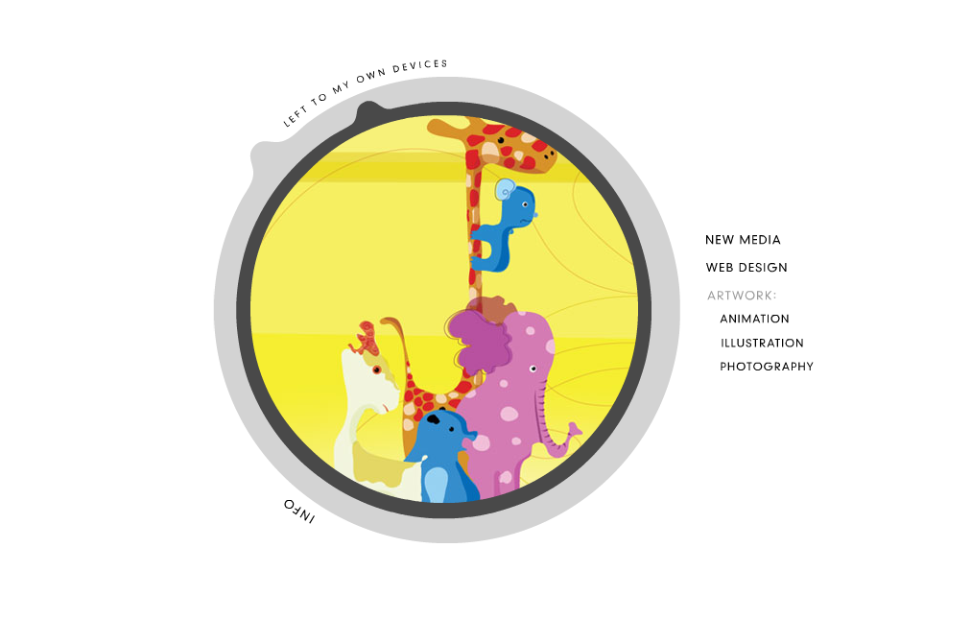
Good Portfolios Can Be Simple
http://www.lefttomyowndevices.com/

Slide 15
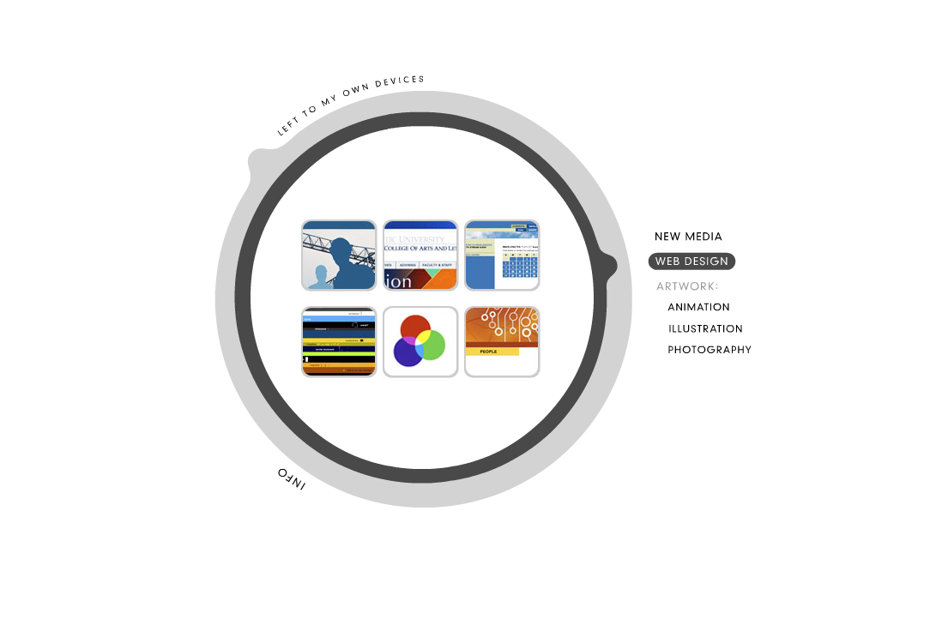
Good Portfolios Can Be Simple
http://www.lefttomyowndevices.com/

Slide 16
Good Portfolios Can Be Simple
http://www.lefttomyowndevices.com/

Slide 17
Good Portfolios Can Be Simple
http://www.lefttomyowndevices.com/

Slide 18
Good Portfolios Can Be Simple
http://www.toby-powell.co.uk/

Slide 19
Good Portfolios Can Be Simple
http://www.toby-powell.co.uk/

Slide 20
Good Portfolios Can Be Simple
http://www.toby-powell.co.uk/

Slide 21
Good Portfolios Can Be Complex
http://bogost.com/

Slide 22
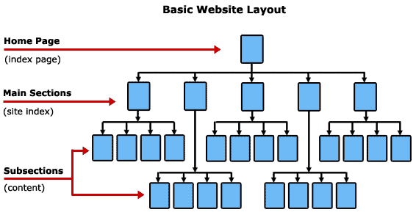
Flowcharts and Planning

Slide 23
Flowcharts and Planning
Graphic Design, Game Design, Photography, Sketching, App dev.,
MMO Campaigning, Programming, Painting, Dance, Comics, Film, Hacking…
You must have at least 4 sections.

Slide 24
Flowcharts and Planning
Accessibility is Important:
Main navigation links should be accessible on every page.
Easy to jump to main page and across categories.

Slide 25
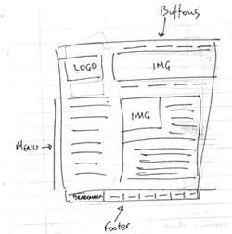
Create Interface Mock-ups
Either loose sketches….or…

Slide 26
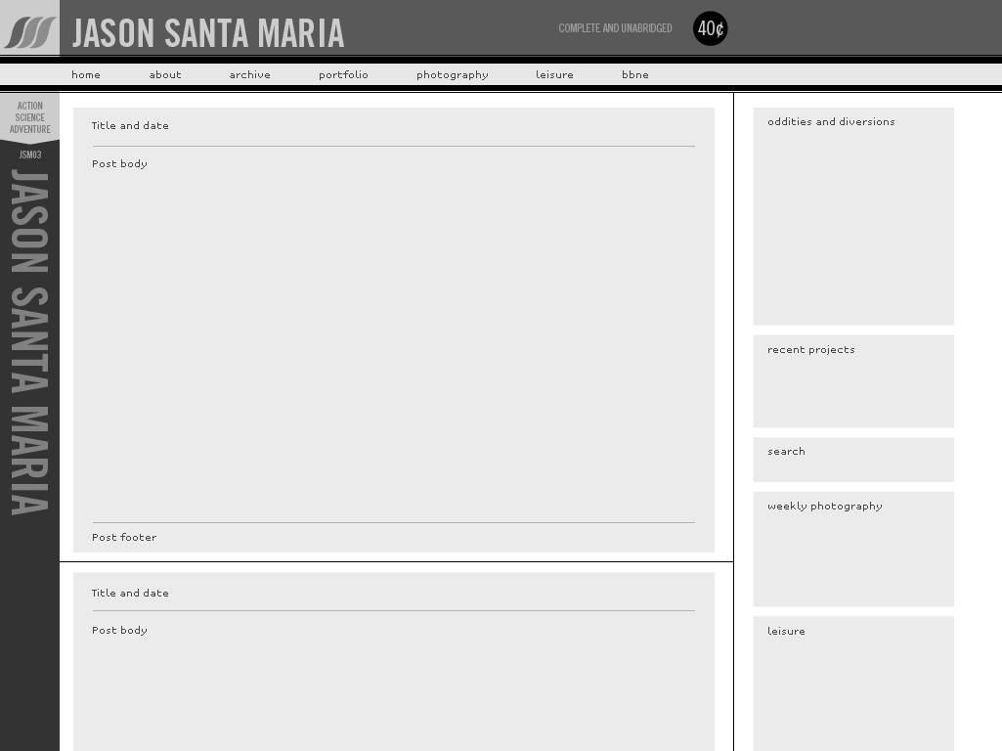
Create Interface Mock-ups
…crisp design plans in Illustrator / Photoshop…

Slide 27
Target Your Portfolio to a Career
Animator
Web Developer
Game Designer
Game Programmer
Producer / Project Leader
Illustrator
etc…

Slide 28
Target Your Portfolio to a Career
Animator
Web Developer
Game Designer
Game Programmer
Producer / Project Leader
Illustrator
etc…

Slide 29
Make Info Relevant to the Viewer:

Slide 30
Make Info Relevant to the Viewer:
This list means nothing to the viewer.

Slide 31
Make Info Relevant to the Viewer:
This list means nothing to the viewer.
This list means a lot to the viewer.

Slide 32
Present Relevant Information
http://www.gregsanto.com/gokart/index.htm

Slide 33
Present Relevant Information
Game Title
Game Description
Programming Challenges
Game Features
Screenshots
Code Sample
Downloads
http://www.gregsanto.com/gokart/index.htm

Slide 34
Present Relevant Information
Game Title
Embedded Video (should add this)
Game Description
Programming Challenges
Features
Screenshots
Code Sample
Downloads
http://www.gregsanto.com/gokart/index.htm

Slide 35
Present Relevant Information
Game Title
Embedded Video (should add this)
Game Description
Programming Challenges
Features
Screenshots
Code Sample
Downloads
Post Mortem (what went right/wrong, lessons learned)
http://www.gregsanto.com/gokart/index.htm

Slide 36
Presenting a Gallery of Images

Slide 37
Don’t only rely on Flickr to present work.

Slide 38
Present some of the best images locally as well
http://www.pixelnitrate.com/

Slide 39
Crop Larger Images to create the most descriptive thumbnails.
http://www.pixelnitrate.com/

Slide 40
Presenting a Gallery of Images
Thumbnails
Crop larger images
Sharpen in Photoshop
Cluster Thumbnails and Larger Images

Slide 41
Cluster Thumbs and Larger Images
click any of these little images
or the text link and…

Slide 42
Cluster Thumbs and Larger Images
The full
gallery
appears.

Slide 43
Presenting a Gallery of Images
Thumbnails
Crop larger images
Sharpen in Photoshop
Cluster Thumbnails and Larger Images
No Need to be Fancy

Slide 44
You don’t need to be fancy with pop ups…

Slide 45
You don’t need to be fancy with pop ups…

Slide 46
Larger images can appear within the page or in a new page… it can load faster.
http://www.pixelnitrate.com/

Slide 47
Embedding YouTube Videos

Slide 48
Embedding YouTube Videos
Click and select resolution
Click Embed
Copy Text

Slide 49
Embedding YouTube Videos
Go to Split View in Dreamweaver
Make sure the cursor is
where you want the video
to be embedded on the page.

Slide 50
Embedding YouTube Videos
Click where cursor is in CODE
Window and paste the text you
copied from YouTube. Save and test!

Slide 51
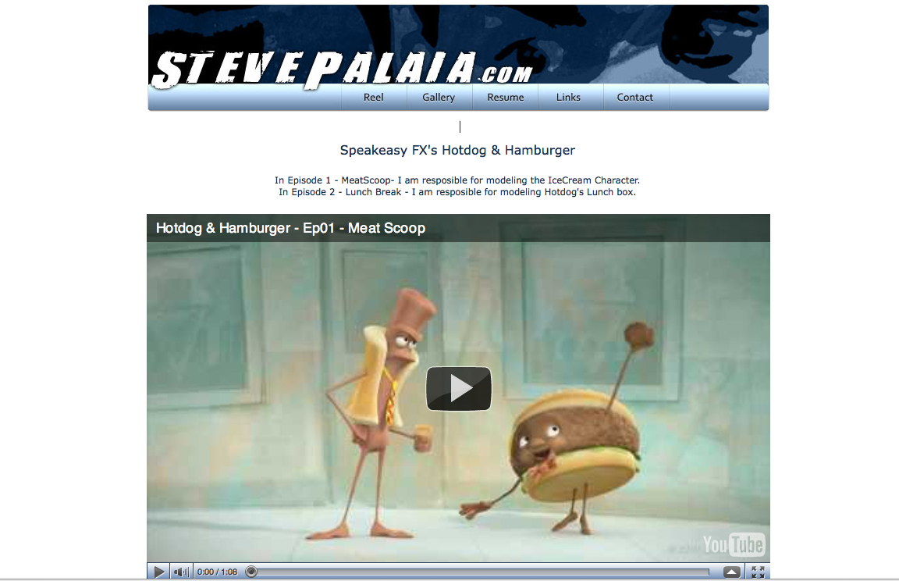
Embedding YouTube Videos

